Slide 1
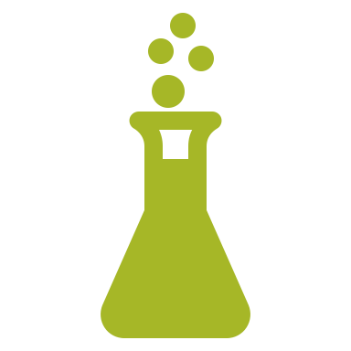
Prebiotic Chemistry: Homochirality
Bio522S 2023-02-08

Slide 2
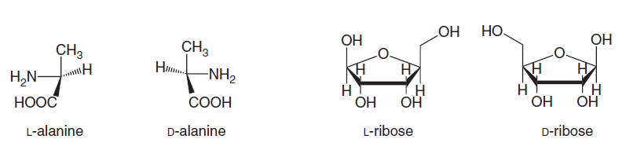
Homochirality
In biological organisms, L-type (left-handed, a.k.a. “S”-type) amino acids and D-type (Right-handed, or “R”-type) sugars are favored as building blocks of macromolecules like DNA, RNA, proteins.
Blackmond. 2019. The origin of homochirality. Cold Spring Harbor Perspectives in Biology. 11:a032540
Notes:
Different naming conventions in chemistry. “s” sinister (for latin left), “r” for rectus, latin for right.

Slide 3
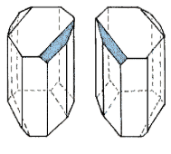
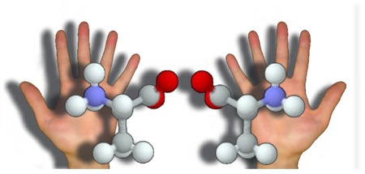
Chirality
In 1832, Pasteur was first to observe the optical difference of a pair of tartaric acid crystals and to separate them in 1848.
https://chem.libretexts.org/
In 1874, the molecular basis of chirality was established. The chiral center is defined as as an atom with four different substituents with two mirror-image forms
http://s8int.com/chirality.html
Notes:
The word “chirality” was coined by Kelvin in 1904

Slide 4
Big question
Why do biological macromolecules use chiral monomers as their building blocks? How did this phenomenon originate?
https://chem.libretexts.org/
In 1874, the molecular basis of chirality was established. The chiral center is defined as as an atom with four different substituents with two mirror-image forms
http://s8int.com/chirality.html
Notes:
The word “chirality” was coined by Kelvin in 1904

Slide 5
Why is this important?
Abiotic synthesis produces a racemic mixture
Known biological macromolecules are (very nearly) enantiopure
“Understanding how modern biology emerged from a presumably racemic pre-biotic world represents an important step in understanding the origin of life” - Blackmond
Blackmond. 2019. The origin of homochirality. Cold Spring Harbor Perspectives in Biology. 11:a032540
Notes:
Different naming conventions in chemistry. “s” sinister (for latin left), “r” for rectus, latin for right.

Slide 6
What are the prerequisites for racemic → homochiral?
Symmetry breaking
Often a stochastic / random process
Amplification of chiral signal
Can be viewed as a deterministic, and in some theories, a regulated process.

Slide 7
Many hypotheses for the origin of homochirality
Asymmetric auto-catalytic amplification (Soai 1995) via interaction with circularly polarized ultraviolet light
Catalyzed reactions (Formose, Strecker, etc)
Crystallization from liquid to solid phase (conglomerates)
Seeding from chiral selection from energy in space (polarized light, beta decay)
Seeding of already chiral molecules from meteorite impacts (Engel 1997)

Slide 8
Symmetry breaking: Circularly Polarized Ultraviolet Light
“Parity violation”: weak forces tip the balance toward one enantiomer
Meinert, C., Hoffmann, S. V., Cassam‐Chenaï, P., Evans, A. C., Giri, C., Nahon, L., & Meierhenrich, U. J. (2014). Photonenergy‐controlled symmetry breaking with circularly polarized light. Angewandte Chemie International Edition, 53(1), 210-214.

Slide 9
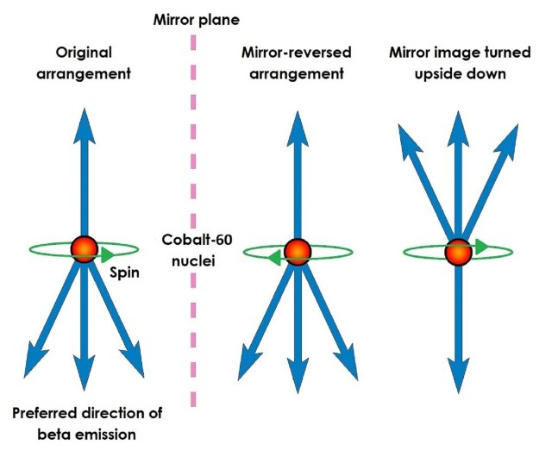
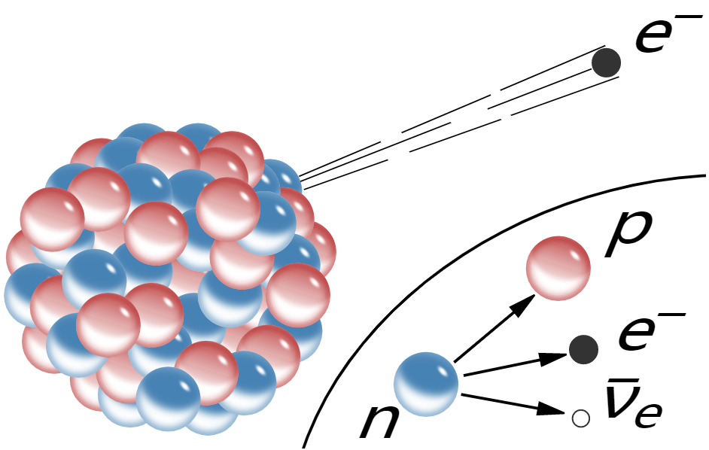
Parity violations: Beta decay and weak forces
Emitted electrons are dominated by one spin, which can influence its interaction with other organic molecules
https://upload.wikimedia.org/wikipedia/commons/a/aa/Beta-minus_Decay.svg

Slide 10
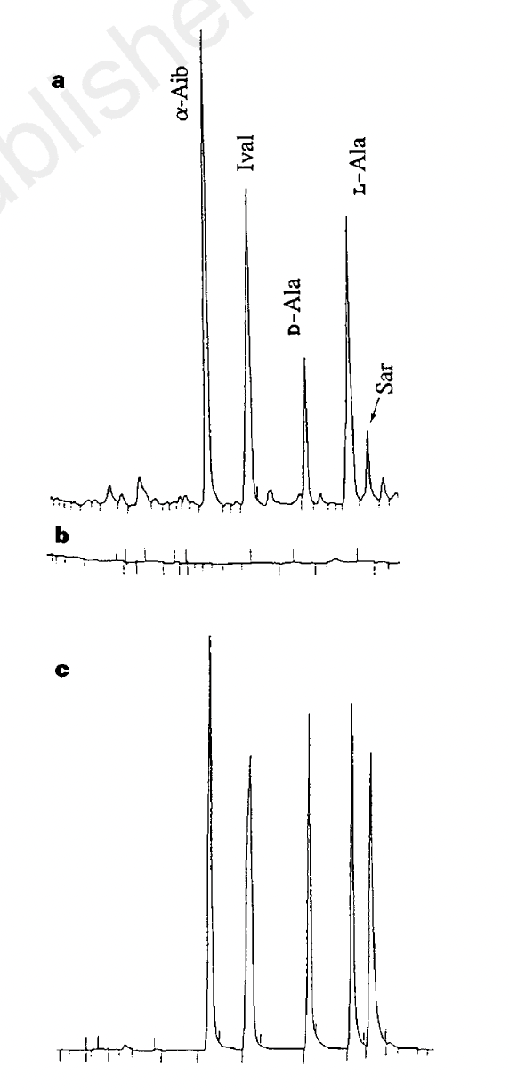
Extraterrestrial source?
Clear evidence for L-amino acid excess.
Timing?
Location and local environment?
Engel et al., (1997). Nature.

Slide 11
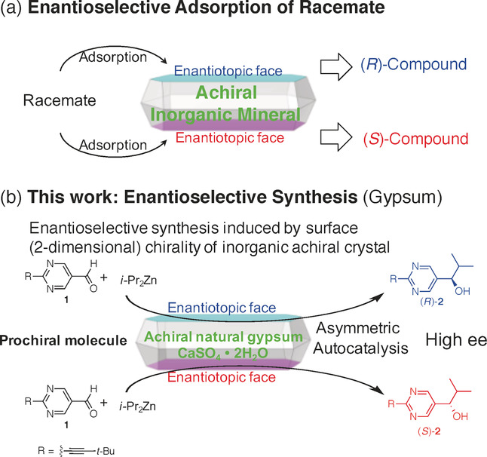
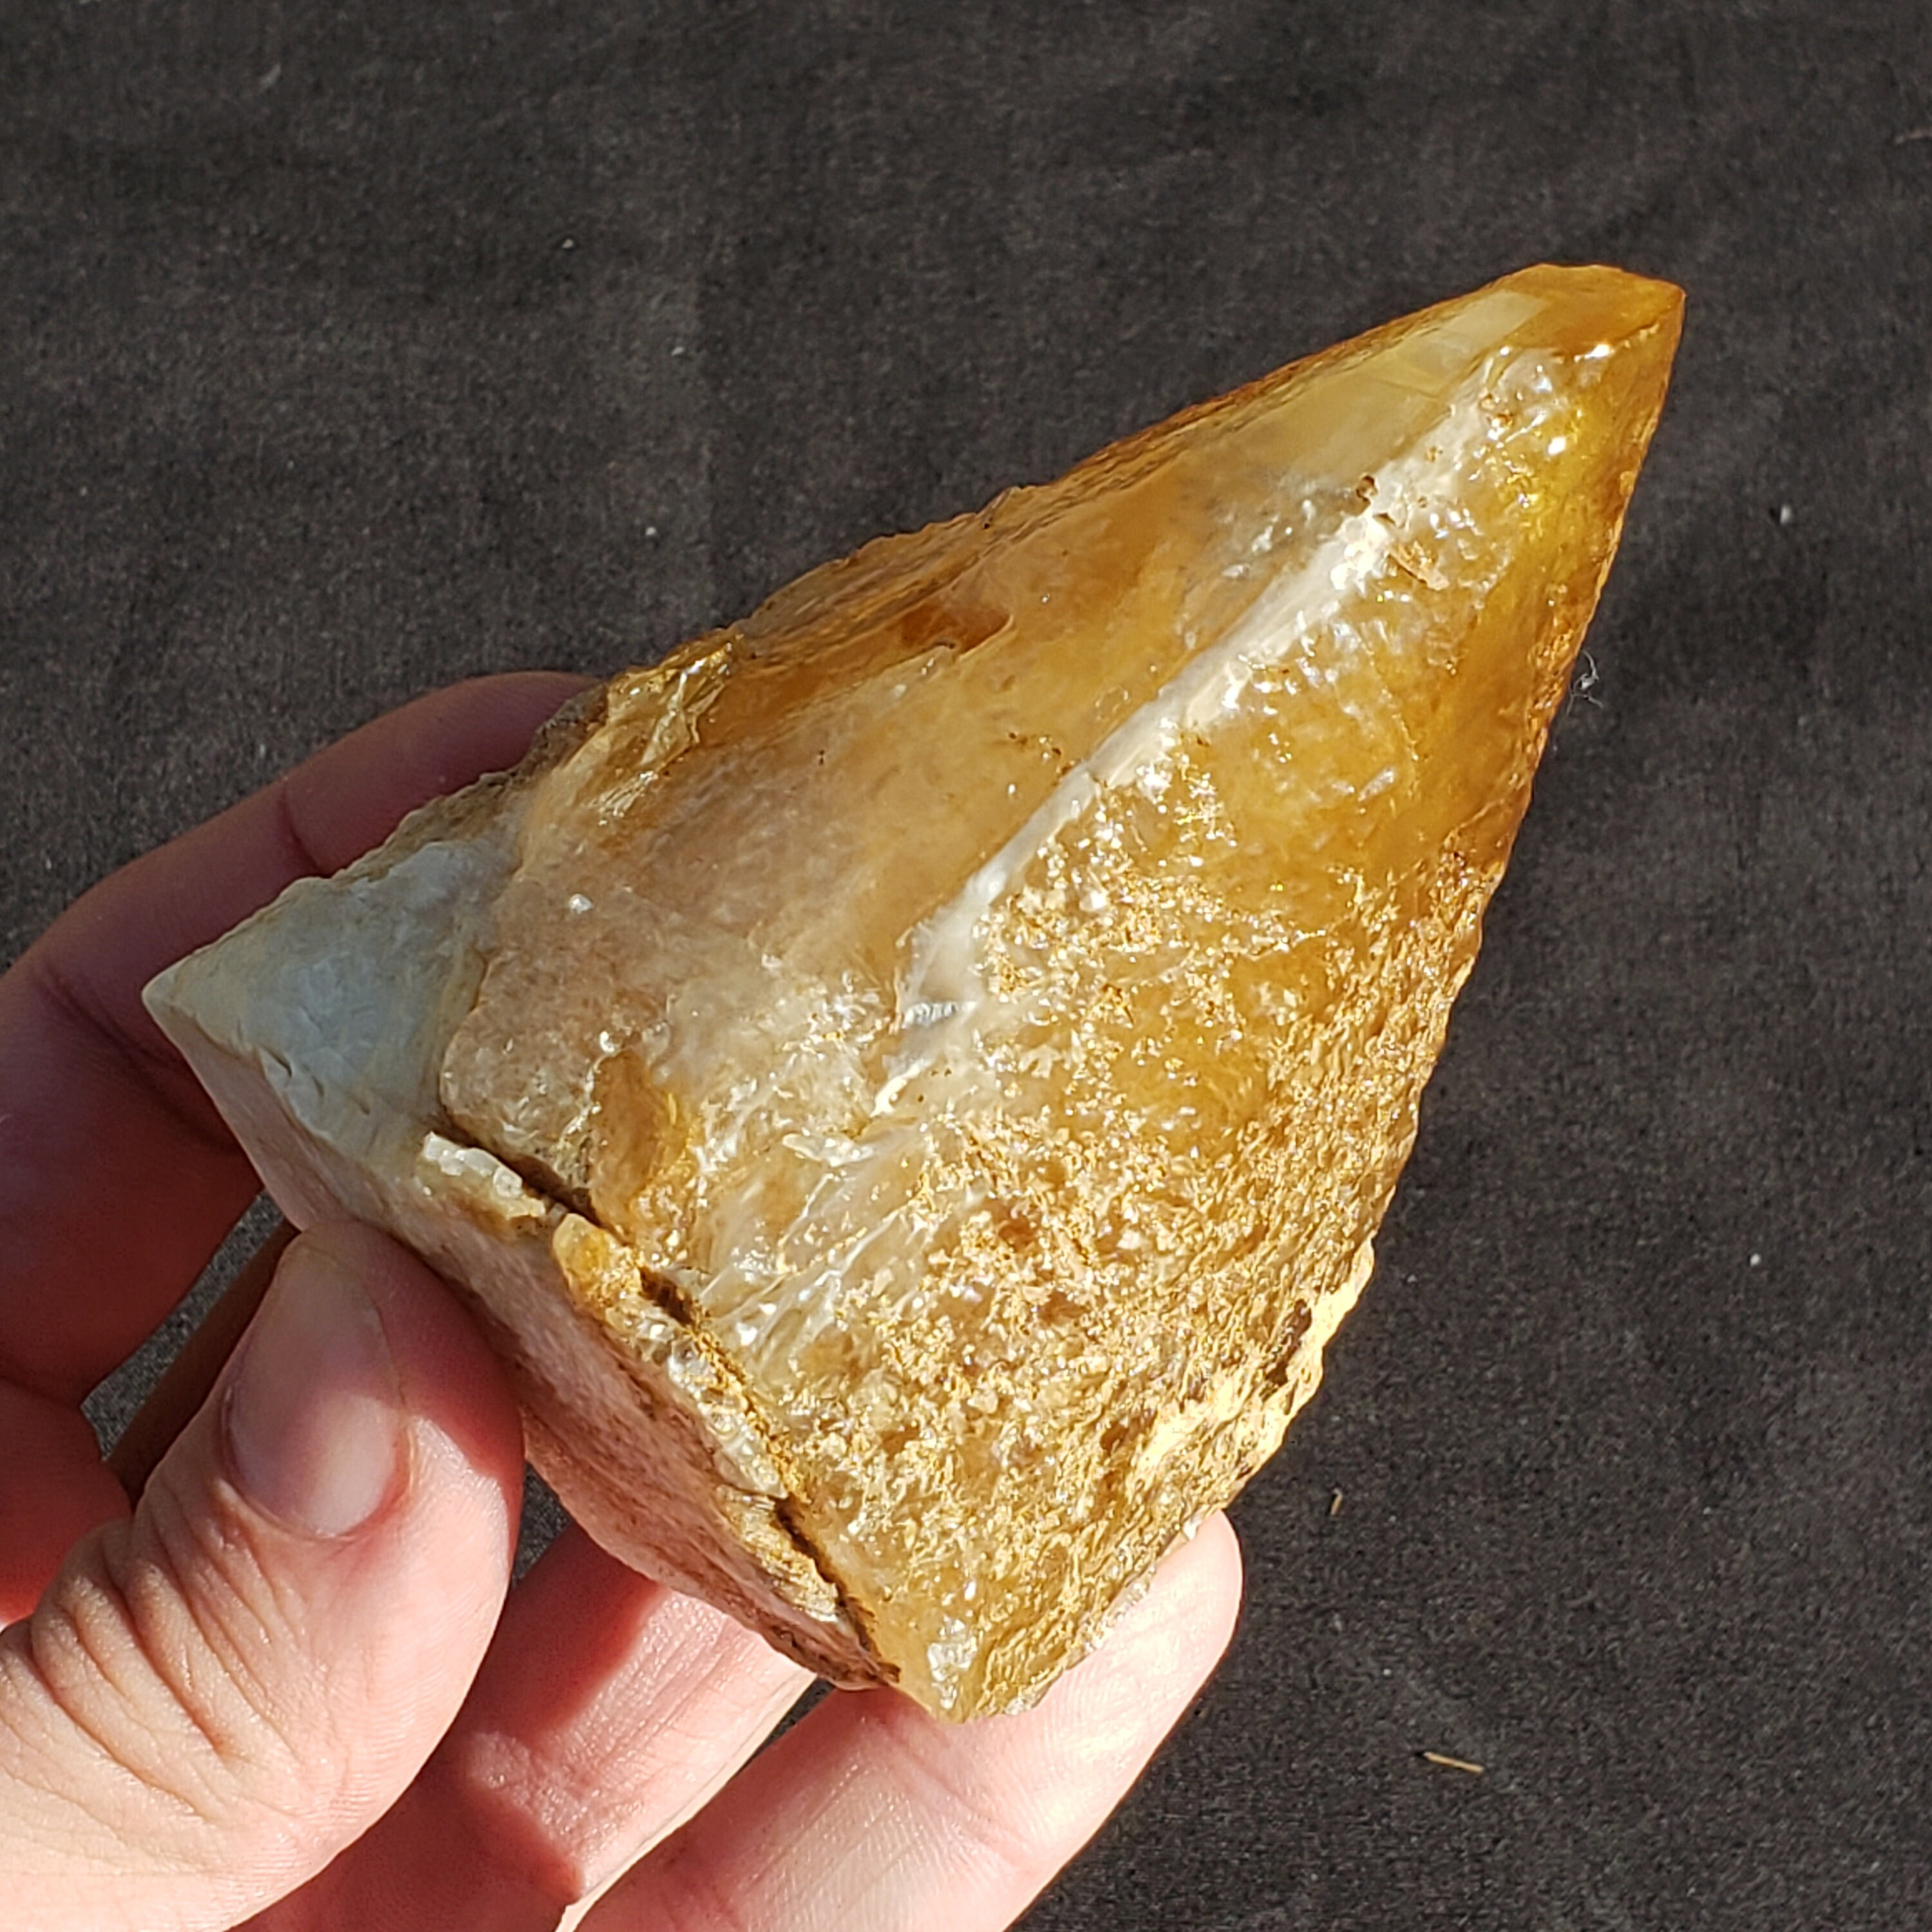
Amplification: Clay mineral surface
2001 Hazen et al: scalenohedral calcite
Matsumoto, A., Kaimori, Y., Uchida, M., Omori, H., Kawasaki, T., & Soai, K. (2017). Achiral Inorganic Gypsum Acts as an Origin of Chirality through Its Enantiotopic Surface in Conjunction with Asymmetric Autocatalysis. Angewandte Chemie International Edition, 56(2), 545-548.
Notes:
Hazen argues for a “local” symmetry breaking event followed by amplification on a chiral mineral surface. What are the time frames of these two events? How would differential timing relate to how rare or common origins were?

Slide 12
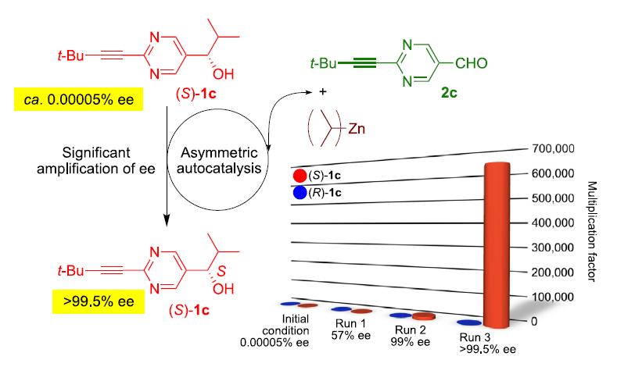
Autocatalytic chemical reaction
Important finding,
but not reflective of prebiotic
conditions?
Soai, K., Kawasaki, T., & Matsumoto, A. (2018). Asymmetric autocatalysis of pyrimidyl alkanol and related compounds. Self-replication, amplification of chirality and implication for the origin of biological enantioenriched chirality. Tetrahedron, 74(16), 1973-1990.

Slide 13
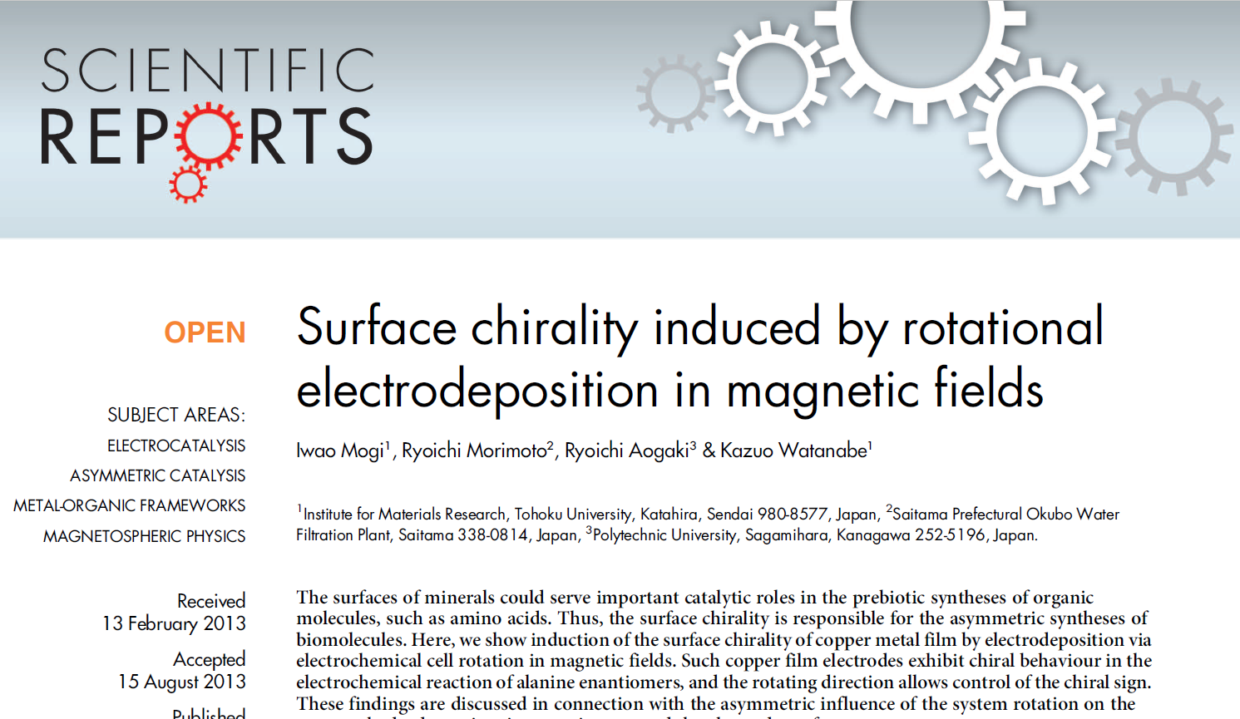
Combined processes?
Matsumoto, A., Kaimori, Y., Uchida, M., Omori, H., Kawasaki, T., & Soai, K. (2017). Achiral Inorganic Gypsum Acts as an Origin of Chirality through Its Enantiotopic Surface in Conjunction with Asymmetric Autocatalysis. Angewandte Chemie International Edition, 56(2), 545-548.
Mogi, I., Morimoto, R., Aogaki, R., & Watanabe, K. (2013). Surface chirality induced by rotational electrodeposition in magnetic fields. Scientific reports, 3, 2574.

Slide 14
Group Discussion Work Flow
Pick topic & Find group
Discussion by group
Report back results
Hear different voices

